Slide 1
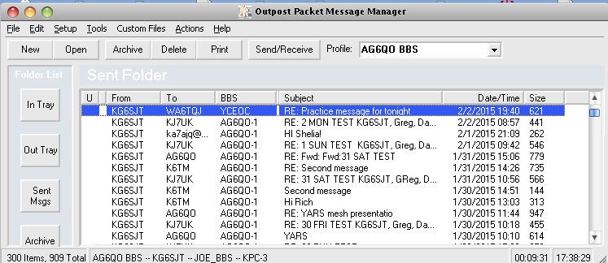
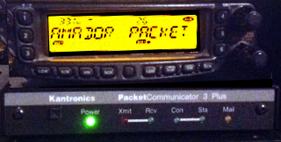
Packet Radio
Greg Kruckewitt, ARRL Sacramento Valley District 3 EC

Slide 2
Topics
Introduction
What is Packet Radio?
Why use Packet Radio?
Building a Packet Station
Software for Sending Packet Messages
Demo

Slide 3
What is Packet Radio?
Amateur Packet Radio is one of many digital modes that Hams can use to build wireless computer networks
Packet establishes a “private connection” between two stations while sharing a frequency with other stations
Packet can use Bulletin Board Systems (BBSs) for dropping off and retrieving messages between users
You can take advantage of packet nodes to connect to distant stations

Slide 4
How Packet Radio Works
Packet Radio uses the AX.25 protocol
Sends packets (an envelope + payload)
  Envelope contains the header at the beginning and a checksum at end
  Header contains addressing information (to, from)
  Checksum determines if packet is error-free
  Payload contains the data to be sent

Slide 5
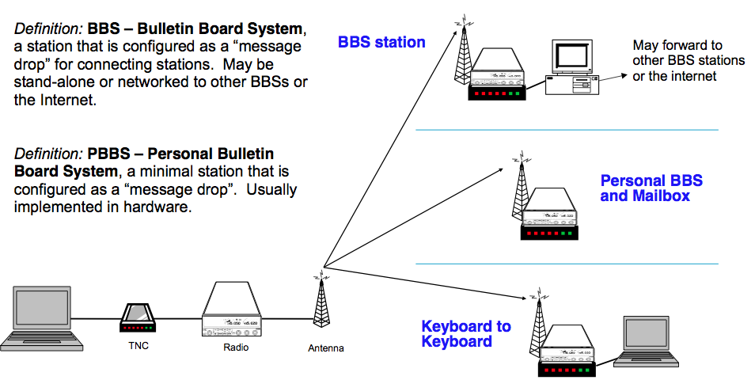
Packet – Making Connections…

Slide 6
Advantages of Packet Radio?
Messages sent to a BBS can be stored and forwarded throughout connected BBS networks.
The recipient does not need to be on-line to get the message, meaning that messages can be retrieved at the recipient's convenience.
This can save computer’s battery power.

Slide 7
Advantages of Packet Radio?
Packet radio is ideal for sending complex messages
  passing lists of material, addresses, instructions, or complex words (i.e. pharmaceuticals or chemicals)
  You would not want to mistake
  Hydrogen Sulphide (a gas) with
  Hydrogen Sulfate (an acid)
  Error checking insures that messages are sent
  error-free

Slide 8
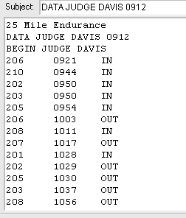
Complex Data Sent from Tevis Ride

Slide 9

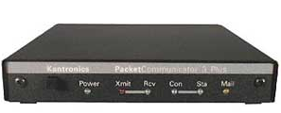

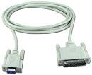
Building a Packet Station
To build a packet station you will need:
  Computer
  Terminal Node Controller
  Radio
  Cables from computer to TNC
  and from TNC to radio

Slide 10
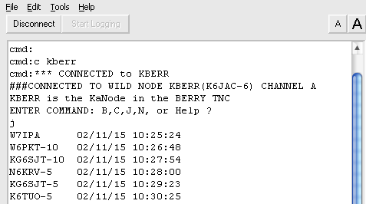
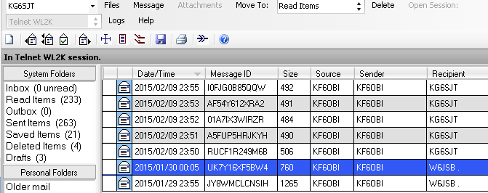
Packet Radio Software
Terminal program
RMS Express
Outpost Packet Manager

Slide 11
Terminal Program
Terminal programs can be used to connect and send short packet messages
Many commands to learn
Can be used for keyboard to keyboard messaging

Slide 12
RMS Express
Designed to be used with exclusively Winlink Email System
Cannot be used to connect to a BBS or PBBS
Ideal to send email anywhere in the world
Can send attachments such as small photos

Slide 13
Outpost Packet Manager
Designed for ARES/RACES Emcomms by Jim Oberhofer, KN6PE specifically for ARES/RACES in Santa Clara County. Used by many ARES groups for digital communications in the US.

Slide 14
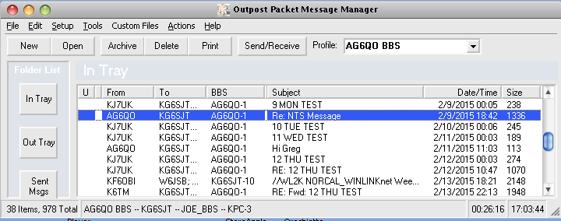
Outpost: Message List

Slide 15
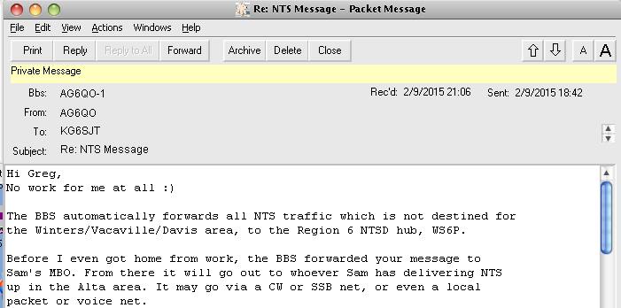
Outpost: Read Messages

Slide 16
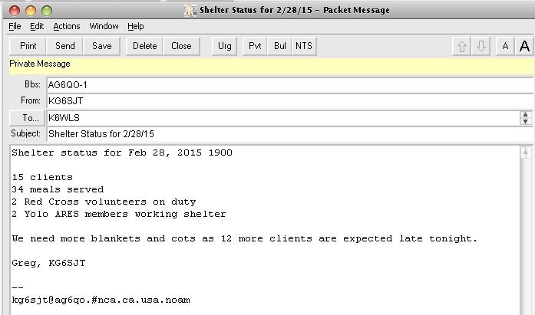
Outpost: Compose a Message

Slide 17
Why Outpost is ideal for ARES
Easy to use, e-mail like interface
Folders: Inbox, Outbox, Sent, Archive, Draft, Deleted
Address book
Automates comms with TNC/BBS – just press Send/Receive
Auto logging of all messages sent and received
Makes printing a message as simple as a click

Slide 18
Packet Radio
Demo using Outpost to connect to:
  Another packet station (peer to peer)
  Connecting to a BBS
  Connecting to Winlink to send a packet email message

Slide 19
Resources
  Contact information
  Gregory Kruckewitt, KG6SJT
  kg6sjt@gmail.com
  cell: 530-219-0611
  Outpost Packet Manager
  http://www.outpostpm.org/
  RMS Express & Winlink
  http://www.winlink.org/
  www.sacvalleyares.org
  Links to this presentation as well as information on
  packet and many other topics related to ARES.

